Slide 1
Drivers Briefing Pembrey 2025
Welcome to Pembrey 2025
Event: British Truck Racing Championship
Date & Venue: Pembrey 17/18 May 2025
Subject: DRIVERS BRIEFING Giti Hospitality 1800 17 May 2025
Senior Clerk of the Course for this event: Dorothy Uwota
BTRC Clerk of the Course for this event: Robert Lentell
BTRC Deputy Clerk: David Carwright
Stewards Panel: Motorsport UK Andy Dee-Crowne
Event Stewards: Brian Hemings & Mike Sturney

Slide 2
Drivers Briefing Brands Hatch 2025
Event Final Instructions (has links to other documents)
BARC Meeting Final Instructions
BTRC 2025 Championship Regulations (published 27/03/2025)
BTRC 2025 Season Drivers Briefing V1 April 2025
BTRC Drivers Briefing at Each Venue
BARC website BARC H&S Guidance issue 2 February 2025
BARC 2025 Safety Bulletin
BARC Standing Orders 2025
All published documents are enforceable by the Clerk of Course and or Stewards

Slide 3
Drivers Briefing Pembrey 2025
CIRCUIT INFORMATION
Lap length: 1.456 miles/2.348 kilometres
Startline and Control Line (Finish) located in front of Race Control
(see photos)
Pole Position: On the Right
Speed limit in pit lane: 60 km/h (37.28 mph)
Please be aware of where the speed limit starts and ends
(see photos)
When exiting the pits, drivers MUST be aware of competitors on the track.
Start lights are on the gantry on the right above the track before pit exit
Warning Signals/flags Flags & Board at control line & Panel
(and by Radio to team if possible)

Slide 4
Drivers Briefing Pembrey 2025
Driving Standards NCR Ch.12 App.7 Championship Regulations 2.13
Each incident is considered entirely on it’s own merit
2.13.2 Defending a position
Non-contact sport give each room no crowding/pushing/forcing must leave at least one truck width between their truck edge of the track
Intimidation of any form is Not Acceptable
2.13.3 Overtaking
Onus on overtaking truck to complete the move safely
2.13.4 Contact
A driver who gains unfair advantage through contact should surrender that advantage before the lap is completed and also could be subject to penalties
Be careful Turn 1 (hairpin) especially on lap 1

Slide 5
Drivers Briefing Pembrey 2025
Judicial Procedures:
Championship Regulation 4 (a) Penalties
2025 MSUK NCR & FIA International Sporting Code
(Stewards will be present in Race Control for all sessions)
Clerk of Course
Report from Judges of Fact reports for Track Limits – False Starts – In-Race Penalties – Smoke – Over-speeding – Technical – Behaviour
Driving Conduct:
All reported incidents will be
Noted [displayed on timing screens] initial review by Clerk of Course
“No investigation necessary” or “Under Investigation” [displayed on timing screens]
Summons - Investigation & Stewards Decision

Slide 6
Drivers Briefing Pembrey 2025
Virtual Safety Car [VSC]
Radio message(s) to Teams from Race Control
VSC being deployed in 15 seconds 5,4,3,2,1 VSC deployed
[displayed on all panels]
60 KPH all trucks – leader becomes Safety Car – you can catch up apart from when in the yellow sector – no excessive speeds or movements – when all trucks lined up VSC will end
VSC ending in 15 seconds 5,4,3,2,1 VSC ended Panel Lights off
Green Light on Gantry Information Board and All Panels
Stay in single file until Control Line is crossed
Race may extended up to 3 minutes following this procedure
Depending on timetable restraints/circuit curfew

Slide 7
Drivers Briefing Pembrey 2025
Track Limits: [MSUK for this event Not FIA]
A driver will be judged to have left the track if any part of the contact patch of any tyre of the vehicle goes beyond either the outer edge of any kerb or the white line where there is no kerb. (next slide)
During Qualifying:
Lap time on which the breach occurred will be disallowed but will still count towards minimum number of laps to qualify.
During Race
First breach Noted
Second breach shown black & white
Third breach 5 second time penalty
Fourth breach further 10 second time penalty
Fifth breach Drive Through (in addition to proceeding time penalties)
Sixth breach Black Flag

Slide 8
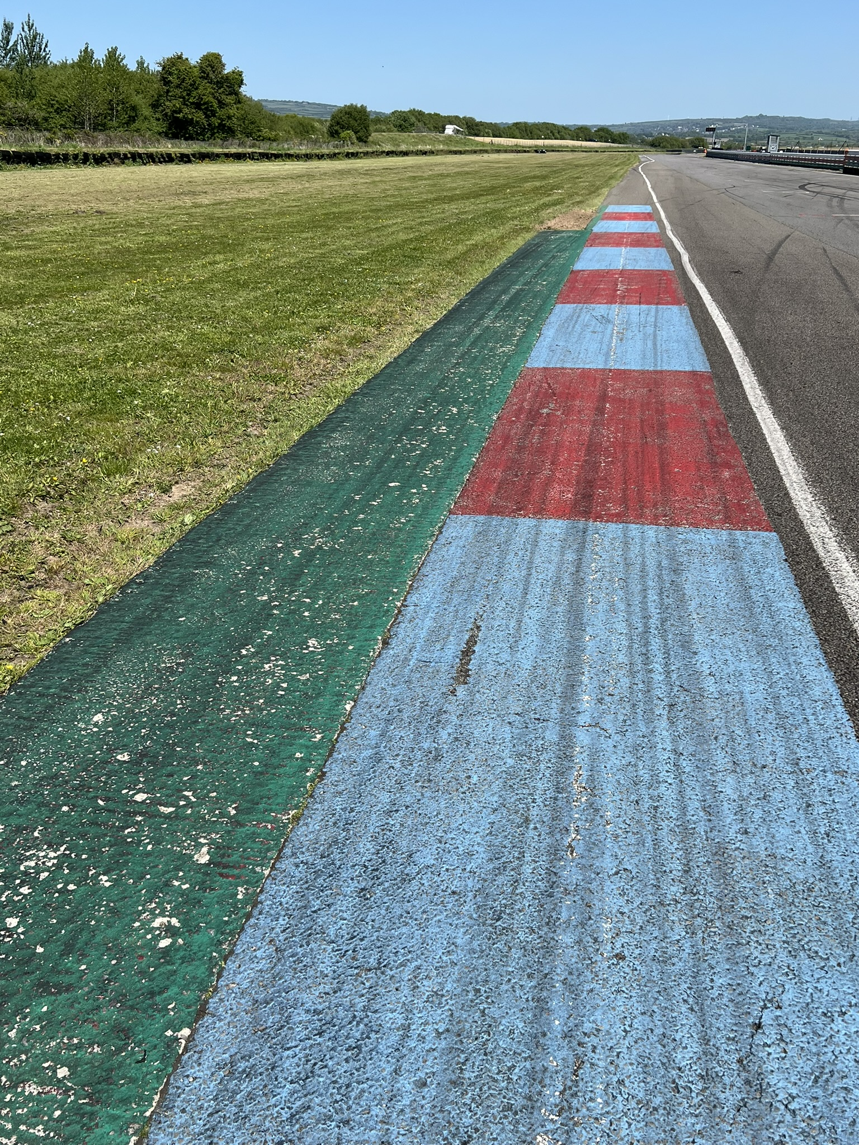
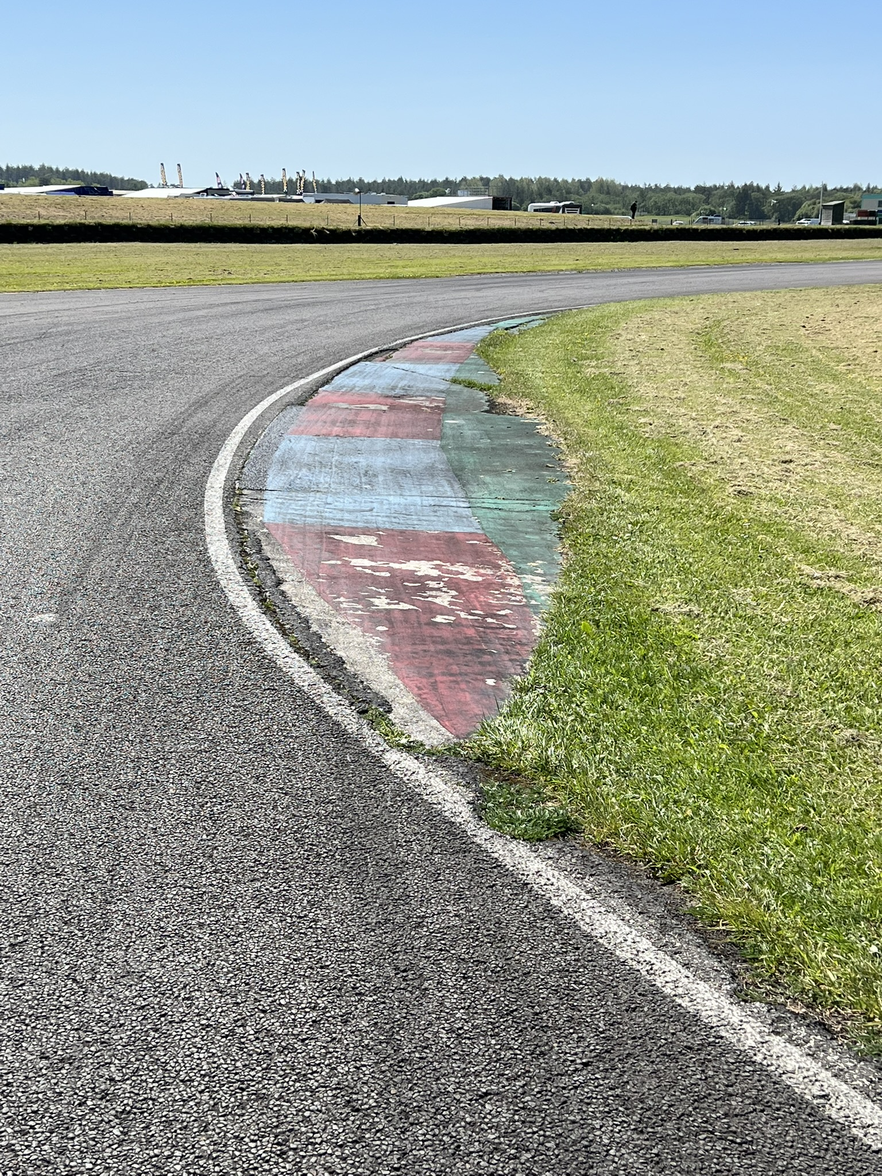
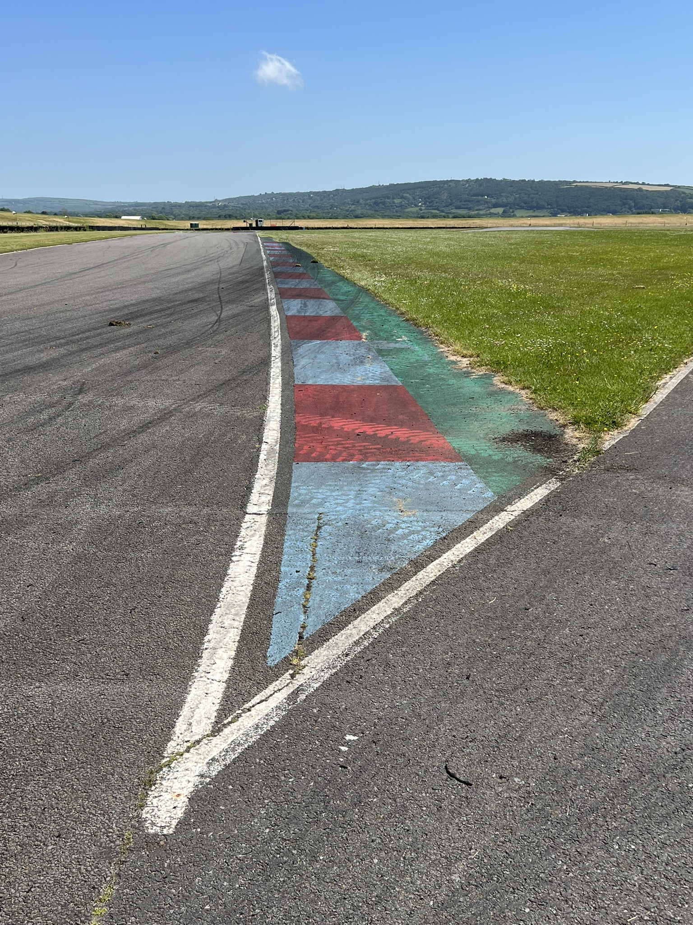
Drivers Briefing Pembrey 2025
Green is not TRACK and over White Line
A driver will be judged to have left the track if any part of the contact patch of any Tyre goes beyond either the outer edge of any kerb or white line where this no kerb

Slide 9
Drivers Briefing Pembrey 2025
Movement in Paddock
No TRUCK Movement without the banksman being present at ANY TIME apart from On-Track and in the Pits

Slide 10
Drivers Briefing Pembrey 2025
Procedure to Assembly:
Refer to Final Instruction for Event
Procedure for Release:
See Final Instructions for Event
[No mechanics on grid unless authorised]
It is your responsibility to ready.

Slide 11
Drivers Briefing Pembrey 2025
RACE START PROCEDURE
See Event Final Instruction
Green Light on Start Gantry [Rolling Start 1 Lap]
Must be in Grid formation by exit Turn 7
Start speed dictated by Pole Position 50 to 65 KPH
[monitored by Judges of Fact]
Racing starts when RED Lights go out

Slide 12
Drivers Briefing Pembrey 2025
In Race Instructions/Information & Penalties
Displayed on Flags & Boards and where possible Radio to team
VSC Radio instruction to Teams
Black/White: With number
Black/Orange: With number
You must come into the pits on the next time at pit lane entry
Stop/Go & Drive through penalties MUST be taken within 3 laps.
For the avoidance of doubt, you cannot take a Stop/Go penalty or Drive through Penalty on the last lap.
Note: Loss of Championship Points (Championship Regulation 1.6.3) resulting from NCR Licence Penalty Points (Ch.2 App.12 Art.1.2 – 1.5)

Slide 13
Drivers Briefing Pembrey 2025
Race/Session Stop:
All circuit panels will show RED slow down with caution as the track may be blocked or obstructed –
Proceed to PITS during qualifying –
Proceed to Startline during racing stopping short of GRID following marshals instructions for re-griding in the event of a restart

Slide 14
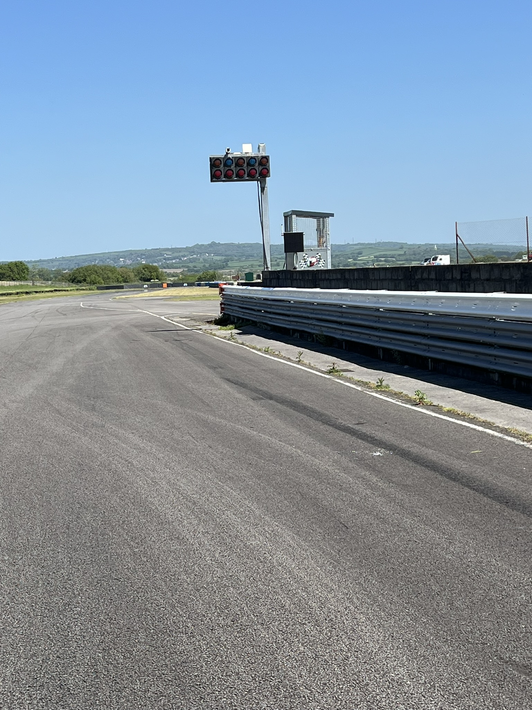
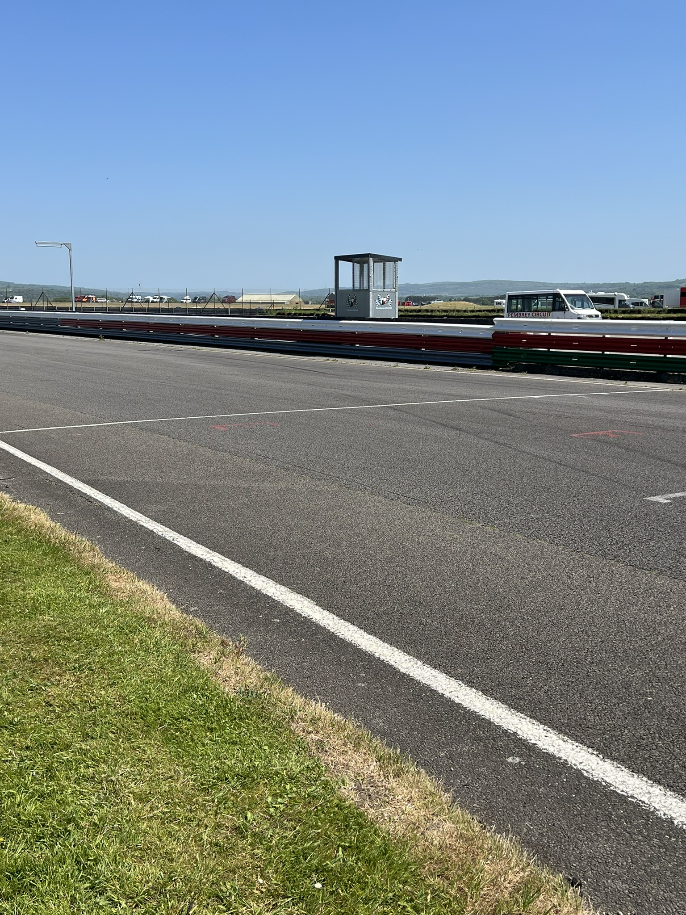
Drivers Briefing Pembrey 2025
Start Lights & Panel
Control Line
Startline

Slide 15
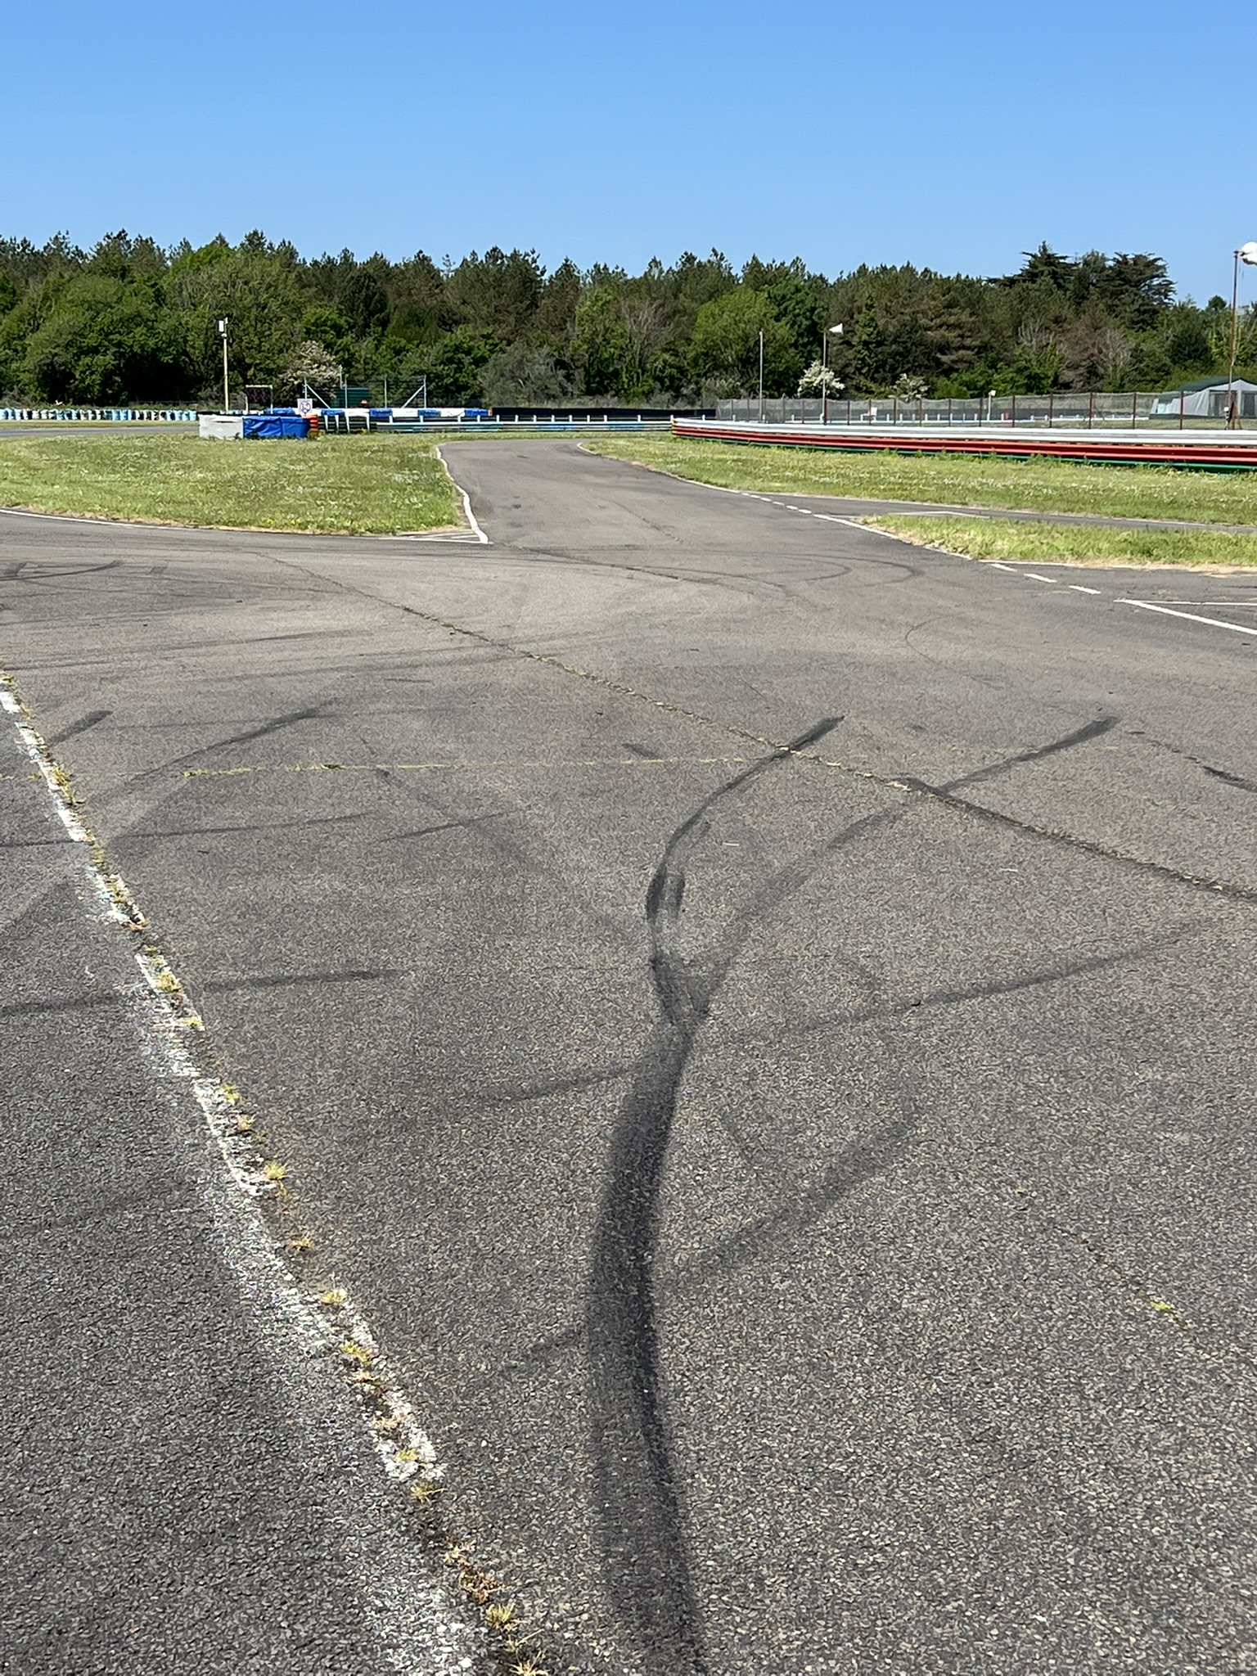
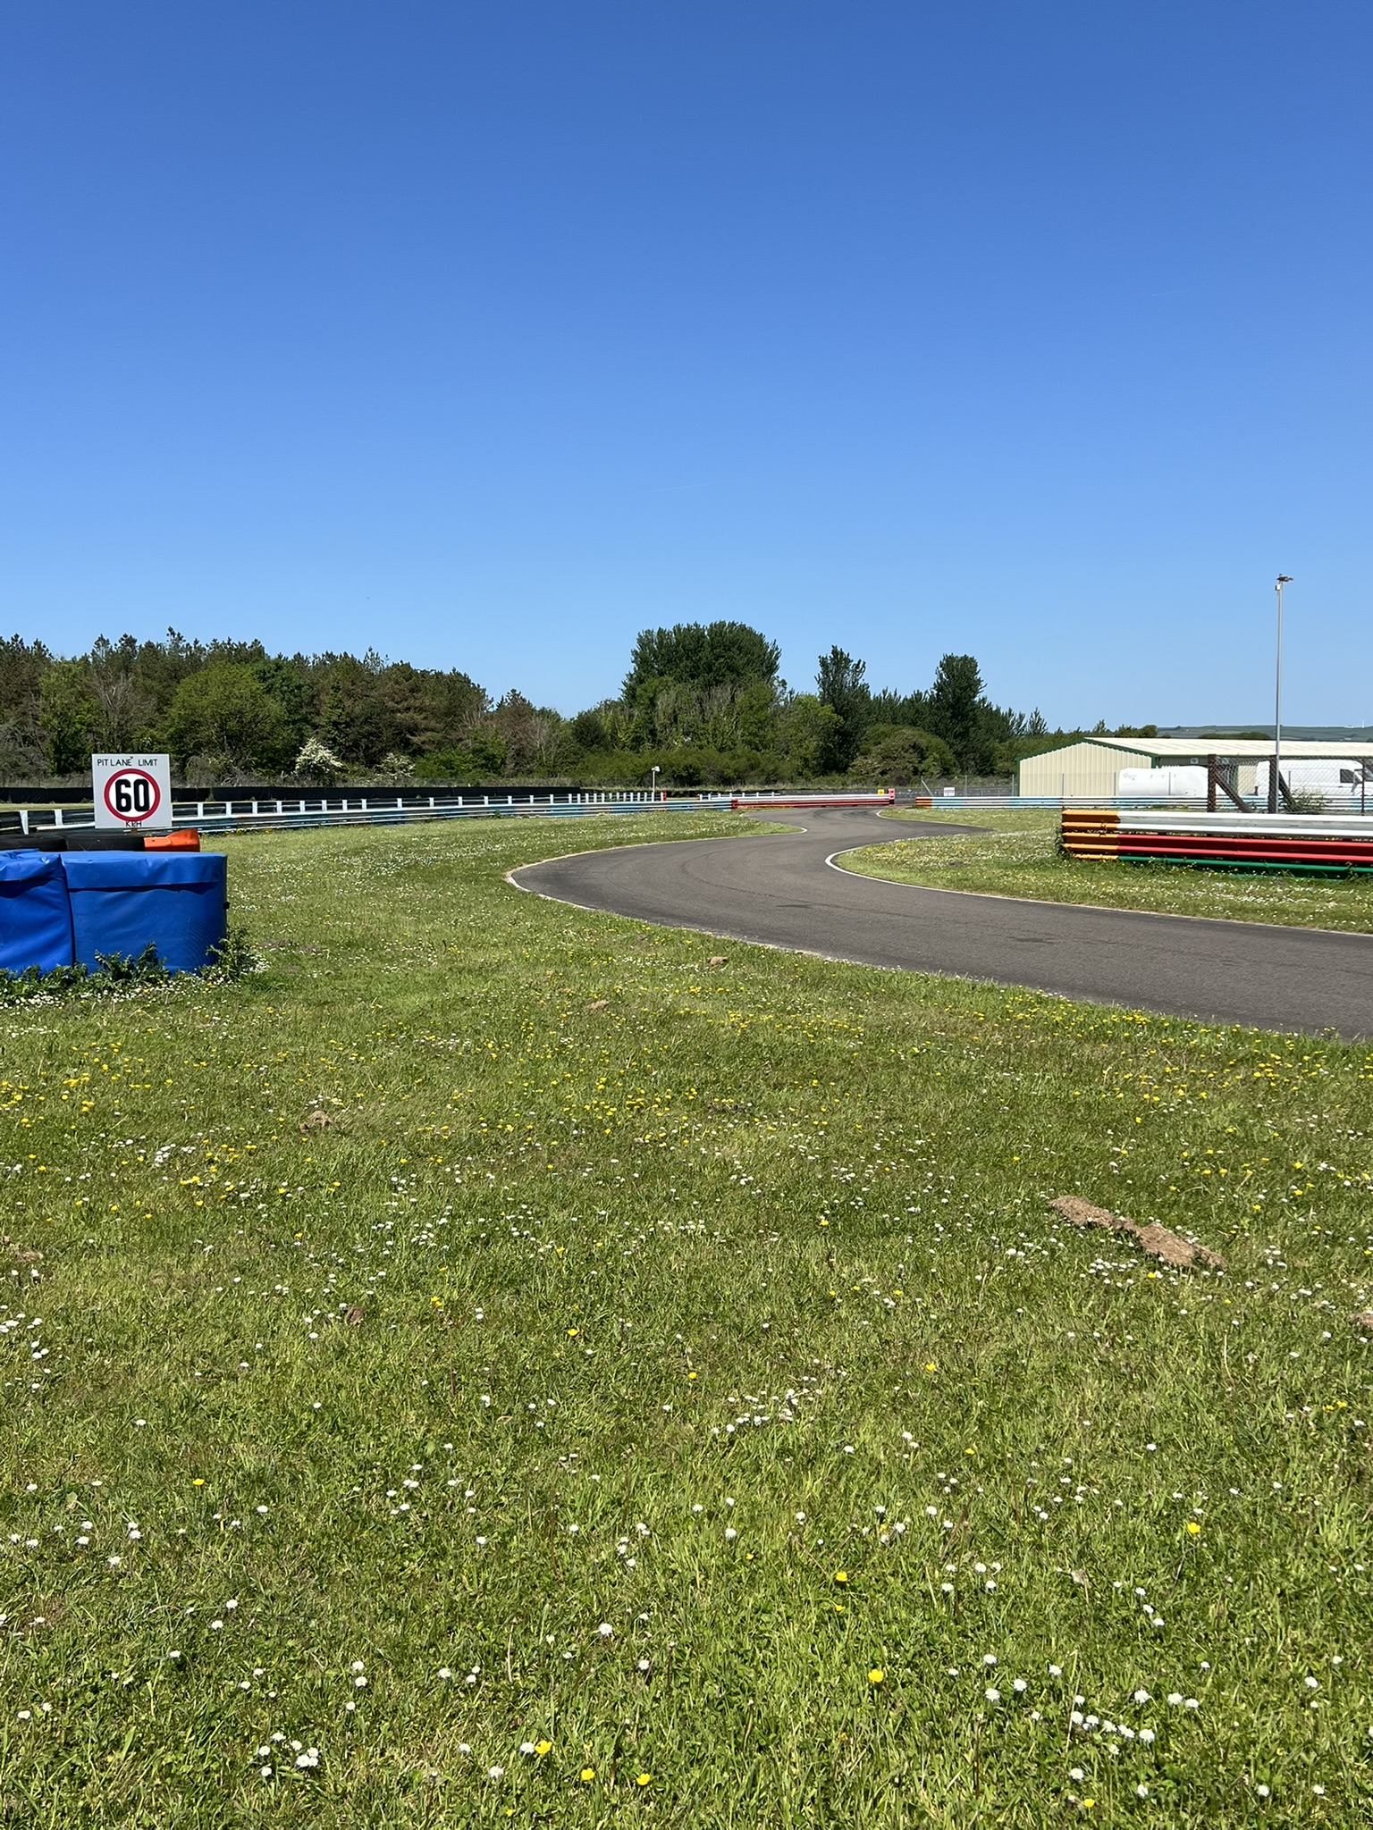
Drivers Briefing Pembrey 2025
Pit Entry
Pit Entry Speed Line

Slide 16
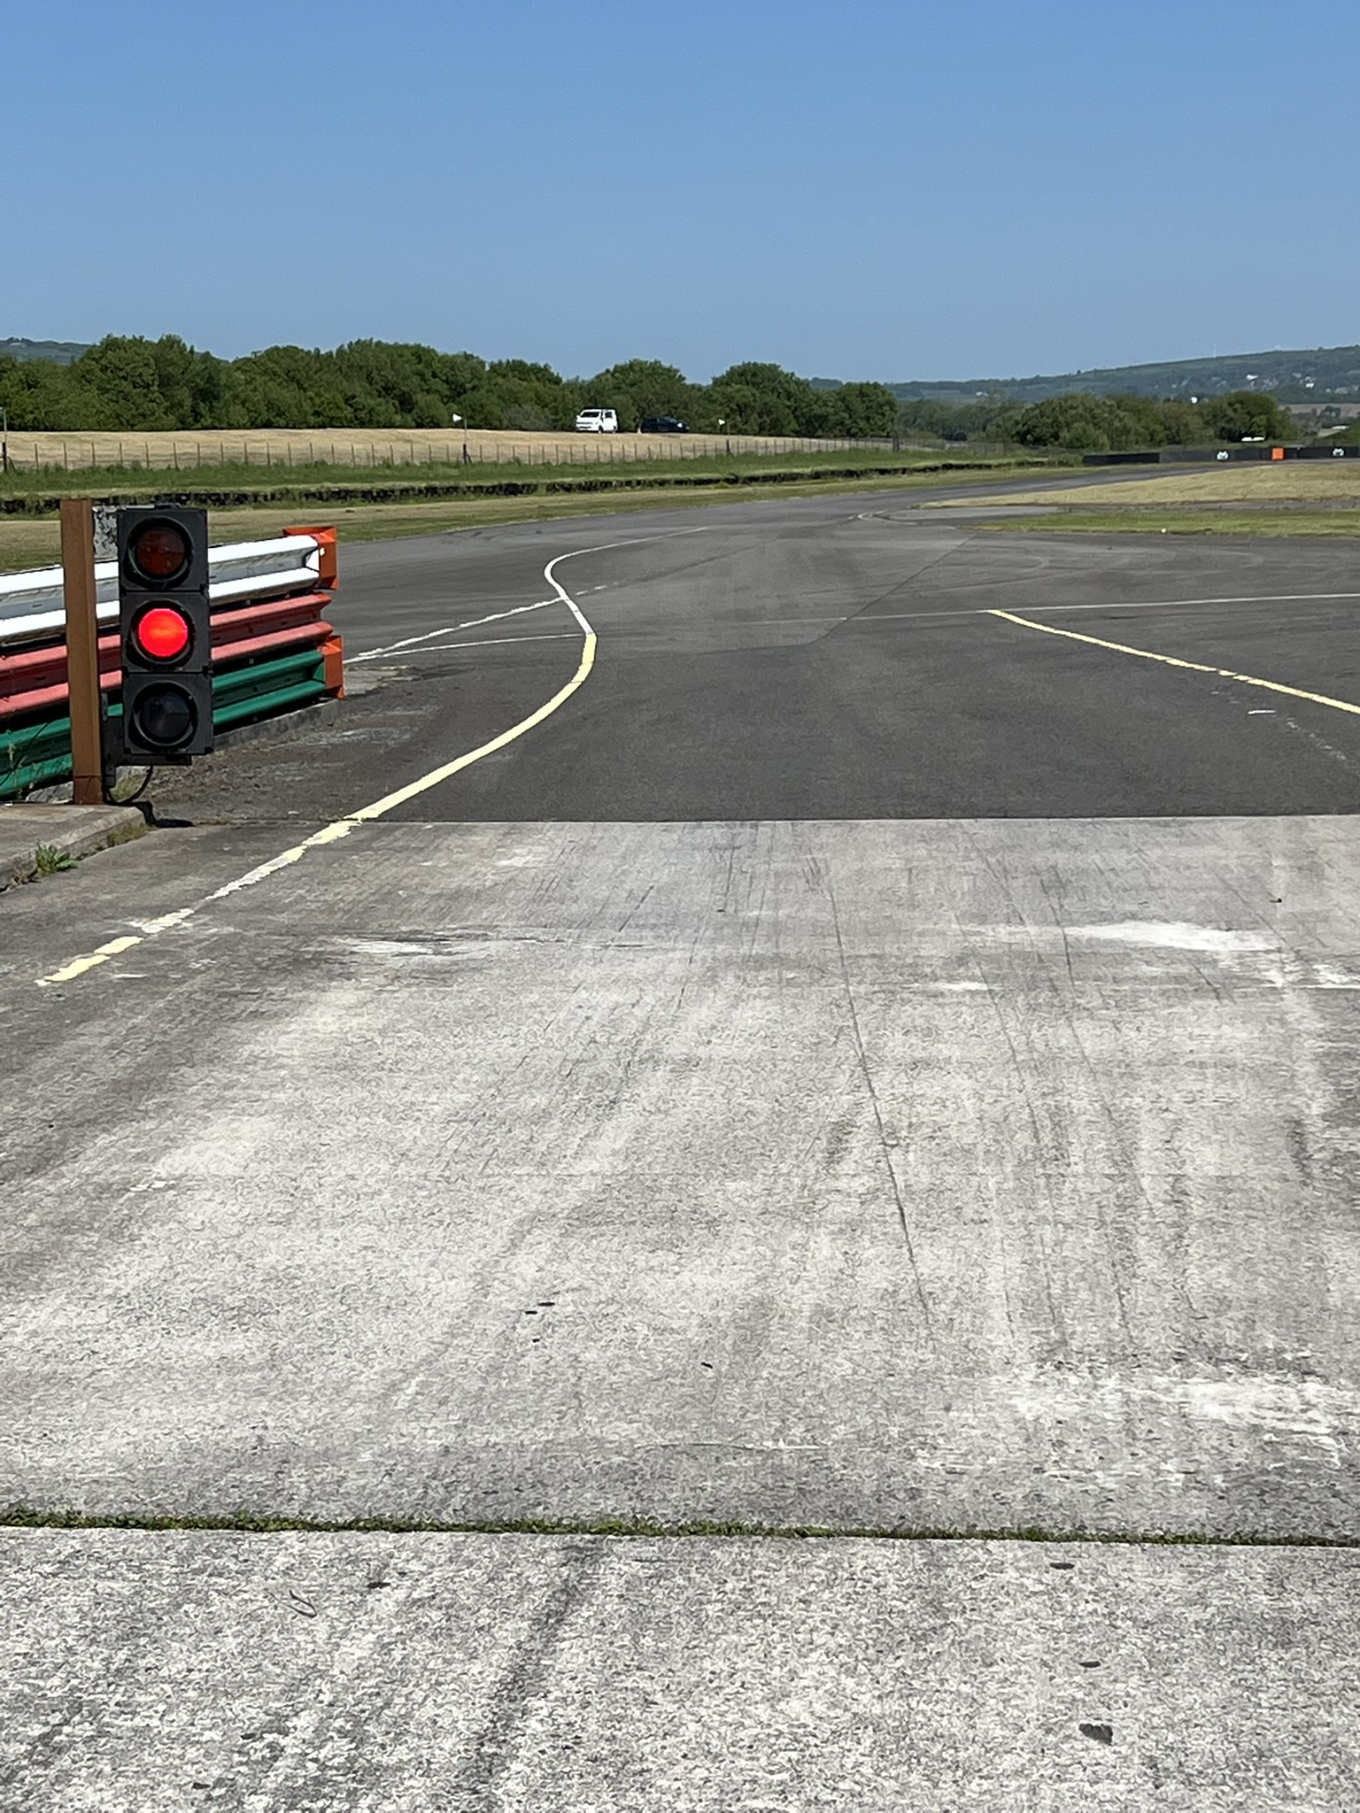
Drivers Briefing Pembrey 2025
Pit Exit Lights
Pit Exit Speed Line

Slide 17
Drivers Briefing Pembrey 2025
Cameras: Championship Regulation 3.8 & 3.9
Camera System (DVR) Digital Video Recorder must be fully functional from leaving awning to returning to awning
(Non-working cameras penalty as per 2025 championship regulations)
Vehicle Isolators Championship Regulation 2.8.2
Competitors must ensure Vehicle Isolator remains continually switched on for 1 hour after the showing of the chequered flag

Slide 18
Drivers Briefing Pembrey 2025
Note:
Follow instructions of Officials & Marshals at ALL TIMES
Extrication Exercise
Saturday 1800 Truck 26
Driver & Truck be ready in Parc Ferme Area by 1745

Slide 19
Drivers Briefing Pembrey 2025
Respect Code:
Full Race with Respect – for full details https://www.motorsportuk.org/racewithrespect/
Any Questions:
Have an enjoyable meeting.
Robert Lentell 140807
Clerk of Course
rlentell.barc@gmail.com
+44 (0)7710 749701

