Slide 1




Drivers’ Briefing
Le Mans Bugatti

Slide 2
Sporting Officials
Robert Lentell, Race Director UK140807
Tel. +44 (0)7710 749701
E-mail. rlentell.barc@gmail.com
Greg Masters Chairman of the Stewards UK
E-mail. thegregmasters@outlook.com

Slide 3
Permit FFSA
International Sporting Code [ISC]
&
2025 Championship Regulations

Slide 4
Best behavior for BTRC to be inviterd back for 2026
You are here to RACE by obeying the rules, putting on a display of good racing to entertain the fans in a Safe Manner.

Slide 5


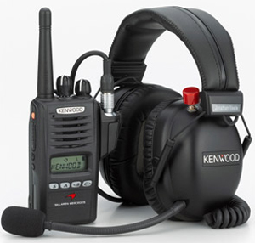
Event Communication
Live Timing
http://livetiming.wige.de/etrc.html
Digital Noticeboard
https://www.barc.net/online
WhatsApp Group – BTRC Driver Notices
Stewards Summons
Team Radio
Please monitor from 30 minutes prior to each session
until 60 minutes after end of Parc Fermé

Slide 6
Timetable / Grids
Saturday
09:20/09:50 – Free Practice – [30 minutes]
11:20/11:55 – Qualifying 1 – [35 minutes]
13:35/14:25 – Presentation of Trucks on Startline followed by lap to the grid [14:30 approx]
14:55/15:20 (5 minute board) – Race 1 – 10 laps – Grid determined by fastest Q1 time
17:40/18:05 – Race 2 – 10 laps – Grid determined by result of R1 with top 8 reversed [PIT Lane Open 17:25 – 17:30]

Slide 7
Timetable / Grids
Sunday
08:00/08:15 – Warm Up – [15 minutes]
09:05 – Qualifying 2 – [35 minutes]
13:00/13:25 – Race 3 – 10 laps – Grid determined by fastest Q2 time
[Pit Lane Open 12:45 – 12:50]
15:45/16:10 – Race 4 – 10 laps – Grid determined by result of R3 with top 8 reversed [Pit Lane Open 15:30 – 15:35]

Slide 8
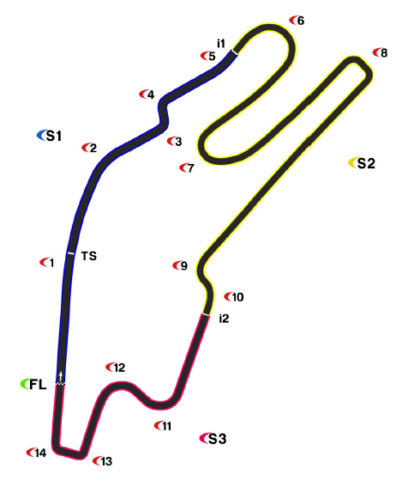
Track Layout 4.185 km
Pole position on the LEFT

Slide 9
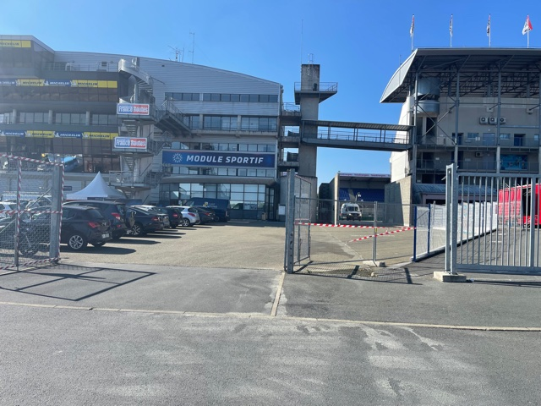

Assembly Area (Pre-Grid)
Trucks will be released into the Pitlane prior to each session commencing

Slide 10
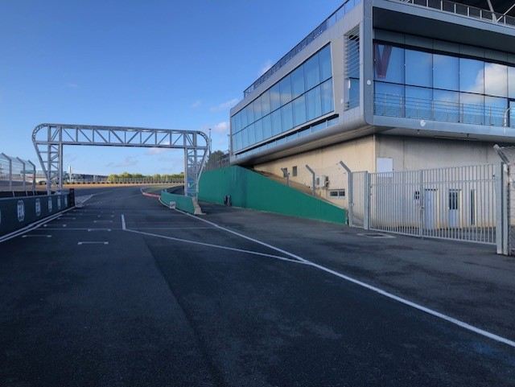
Return to Paddock
Parc Fermé conditions apply after Qualifying and Races until notified via WhatsApp

Slide 11
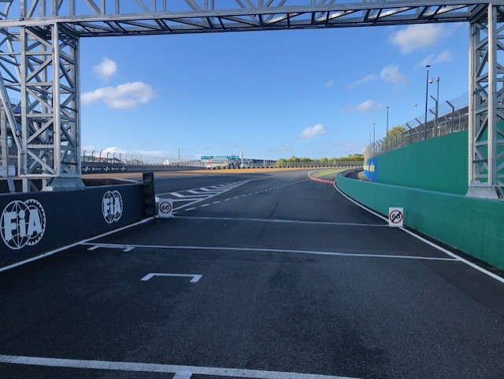
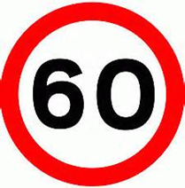
Pit Lane exit
Respect the RED/GREEN traffic lights. RED means STOP
Observe 60kph speed limit until after you pass the pit exit line

Slide 12
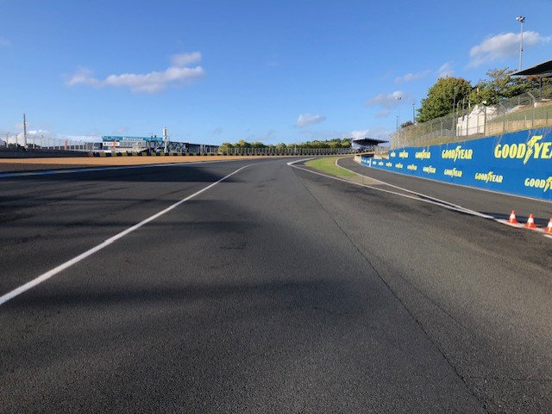
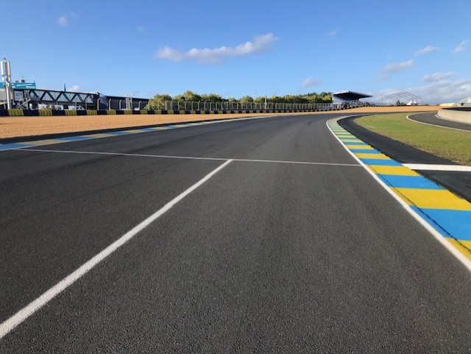
Pit Lane exit
Keep right and do not cross the Pit Exit line

Slide 13
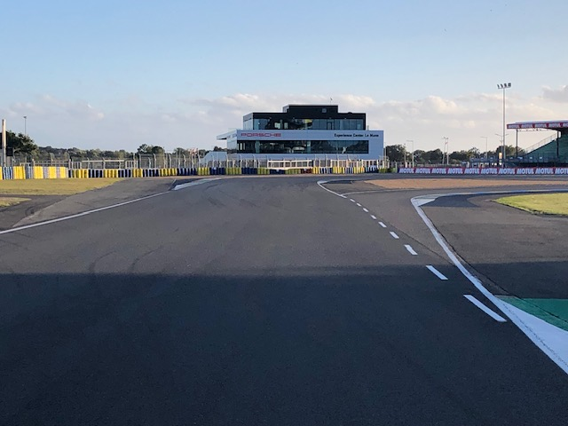
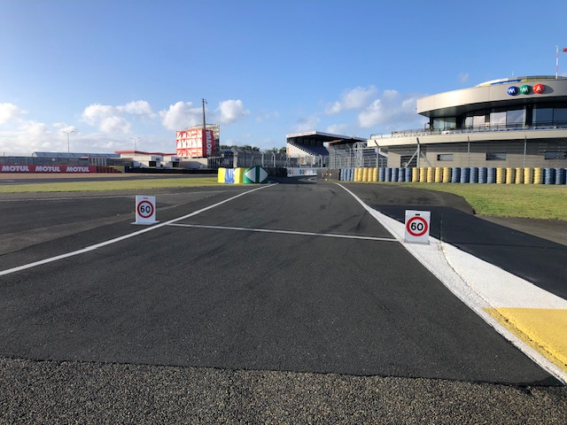
Pit Lane entry
Keep right from exit of Turn 12 and give a clear signal if you are entering the Pitlane
OBEY the 60kph Pitlane Speed Limit

Slide 14
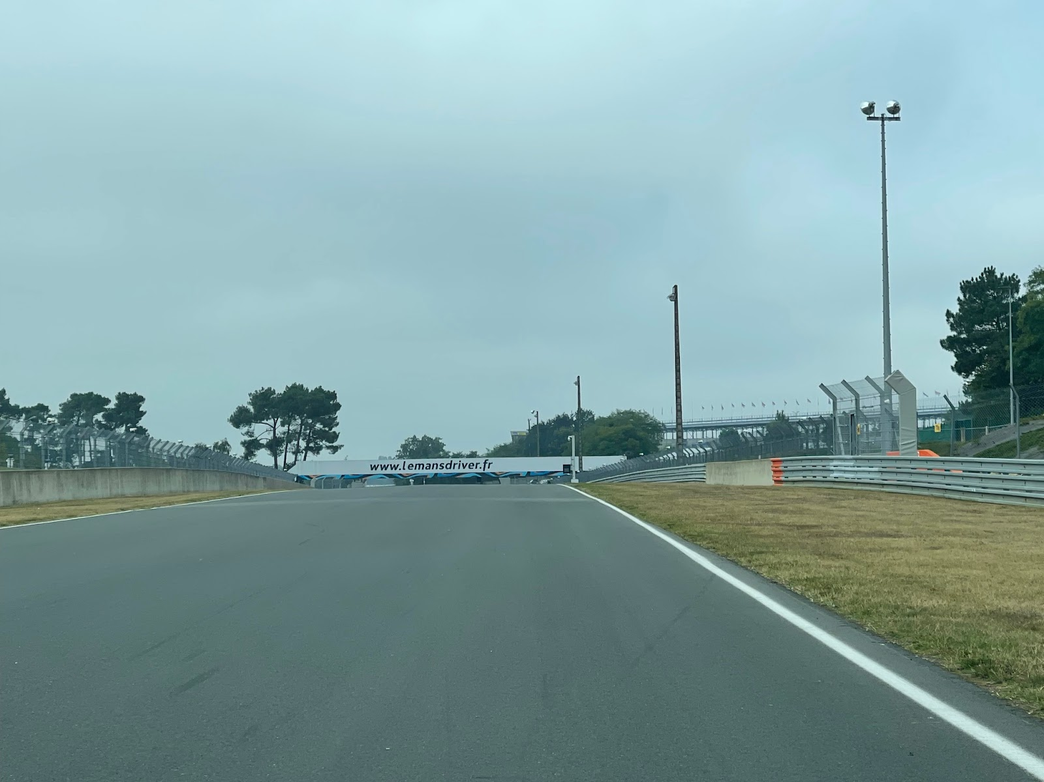




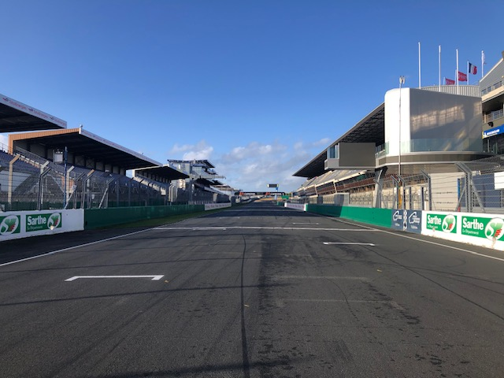
Signaling area / Timing Control & Finish line
DRIVE THROUGH
Repeater flag on right hand side between Turn 8 and Turn 9

Slide 15
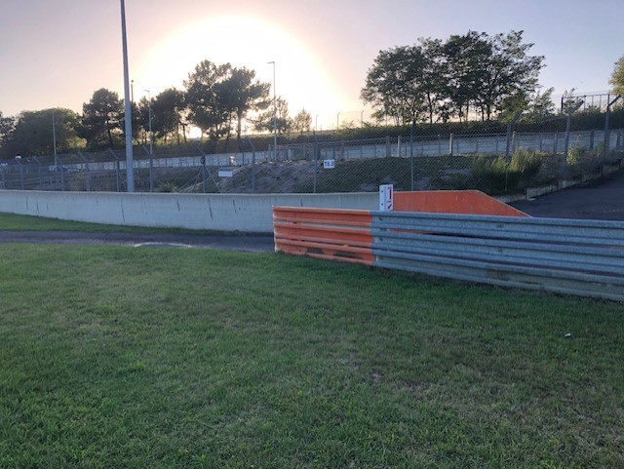
Safety on Track
If you need help on Track please try to stop in a SAFE place near a marshals post
If the truck is in a safe place, get out of the truck and behind the barrier and to a place of safety (openings are marked in ORANGE)
If you remain in the truck give the thumbs up to marshals if you are okay

Slide 16


Yellow Signal (Single):
SLOW DOWN
NO OVERTAKING
Incident close to the Track
No overtaking until after the Green Signal

Slide 17

Yellow Signal (Double):
SLOW DOWN – BE PREPARED TO CHANGE DIRECTION OR STOP
NO OVERTAKING
Incident on the Track or Marshals in attendance
No overtaking until after the Green Signal

Slide 18


Red Signal:
Cease racing
Slow down, maximum 60 kph
No overtaking
Trucks in the final sector (after Turn 10) may pass once through startline to cool brakes
Practice/Qualifying: Enter Pitlane
Races: Stop on track at Turn 13
Clock will not be stopped during Free Practice / Warm Up

Slide 19
Red signal during races
Stop on track at Turn 13 adjacent to the Pitlane Entrance and await marshals instructions

Slide 20
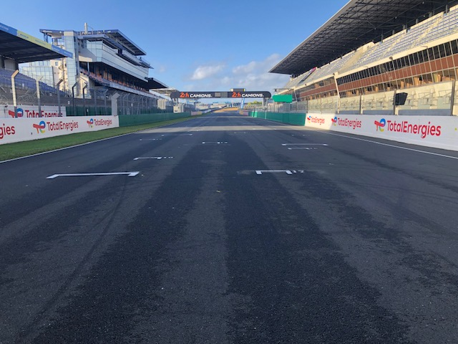
Start procedure
Pit Exit will close 5 minutes prior to the start of the Formation Lap. Only 1-lap permitted to form up on the grid
1-minute board, grid cleared and engines started
One formation lap behind the Pace Truck
Line up between T10 and T11
Leader to control the pace, 50 – 65 kph 2 straight lines as championship bulletin No.5 12/09/25

Slide 21
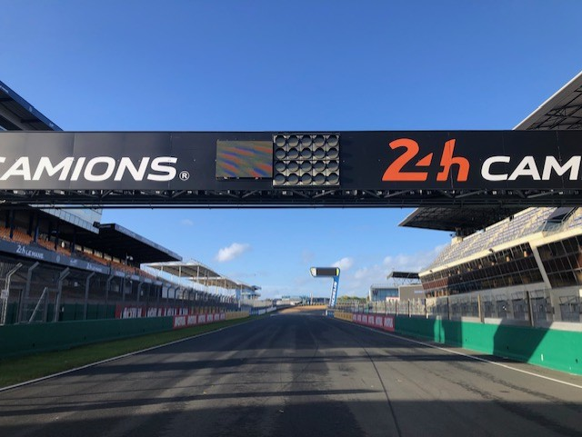
Start lights
The start signal will be given when the red lights are switched to green.

Slide 22
Start lights
The start signal will be given when the red lights are switched to green.

Slide 23
Aborted start
If the start if aborted the red lights will remain illuminated and yellow lights will flash
All trucks to remain at 60 kph maximum in single file
Either red signal or VSC procedure will commence

Slide 24
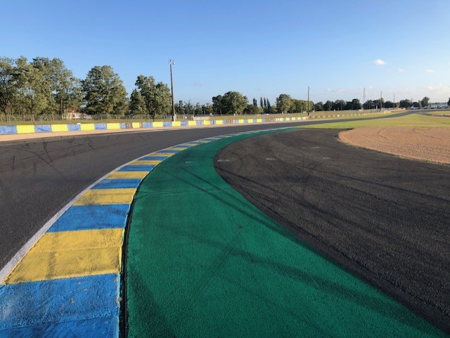
Track limits
For consistency of reporting, track limits at this event will be defined in accordance with FIA ISC Appendix L.
The white lines define the track edge.
The truck must remain in contact with the track.
Making contact with any bollard is prohibited.

Slide 25
Track limits
During Practice: Drivers will be warned and stopped if necessary
During Qualifying: Lap time will be cancelled
During Races: the following scale of penalties will be applied:
1st breach - noted
2nd breach - Black & White warning signal
3rd breach - Five-second time penalty
4th breach - Ten-second time penalty
5th breach - Drive-through penalty
6th breach - Black signal

Slide 26
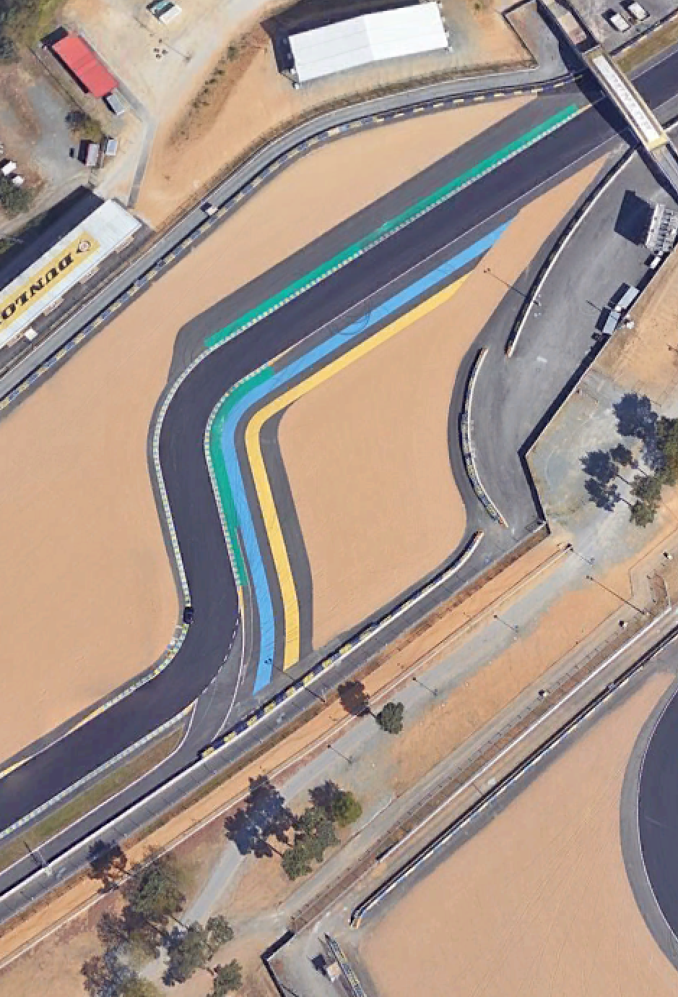
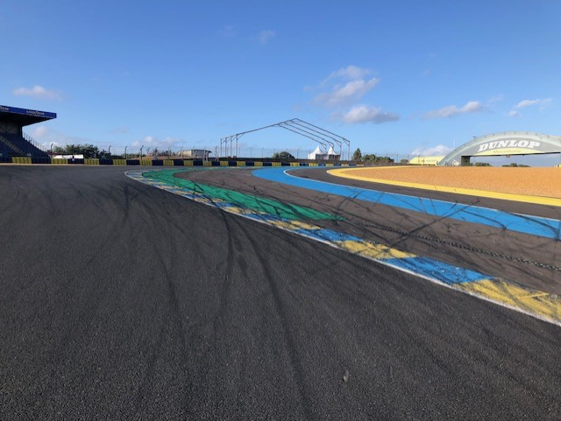
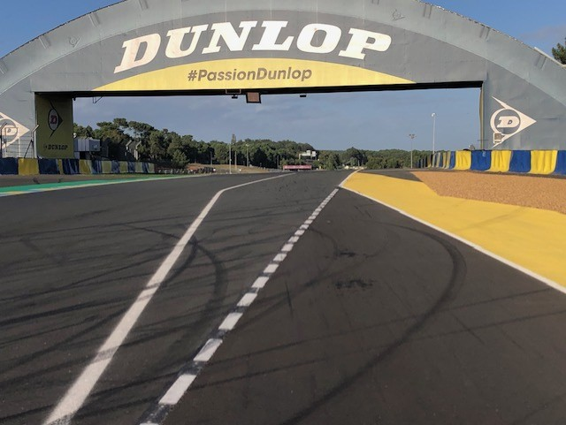
Turn 3/4
If you overshoot keep right and rejoin at the Dunlop Bridge via the escape road without gaining any lasting advantage

Slide 27
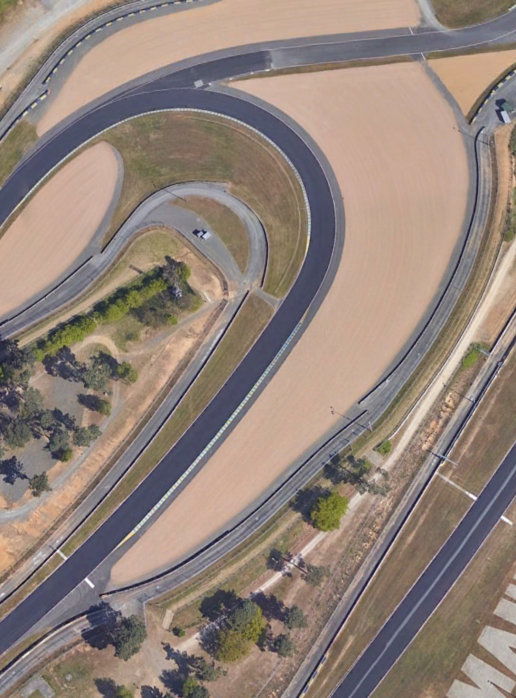
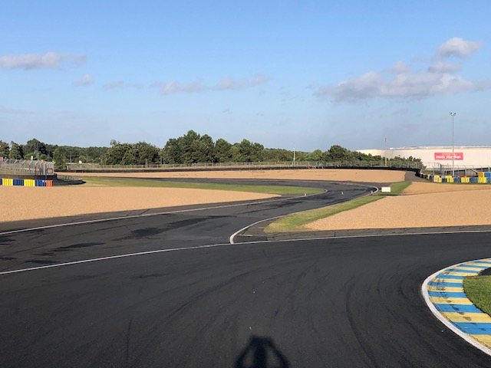
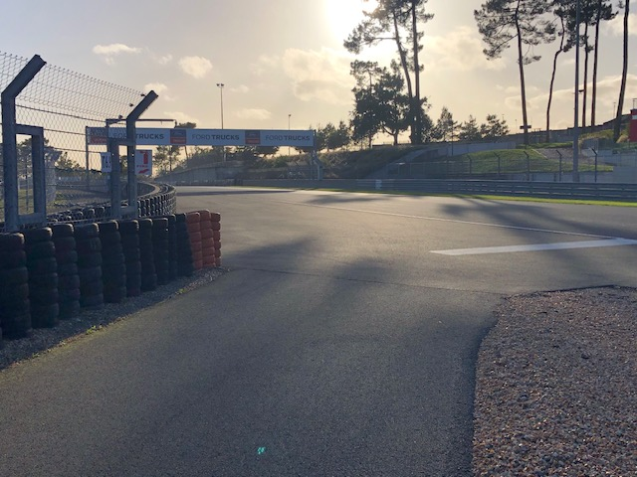
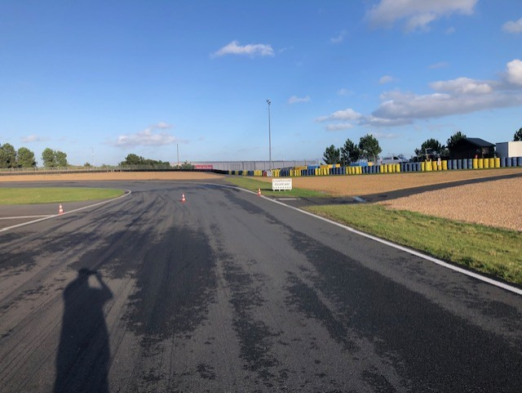
Turn 6 Escape Road
Follow the escape road to rejoin safely (KEEP LEFT)

Slide 28
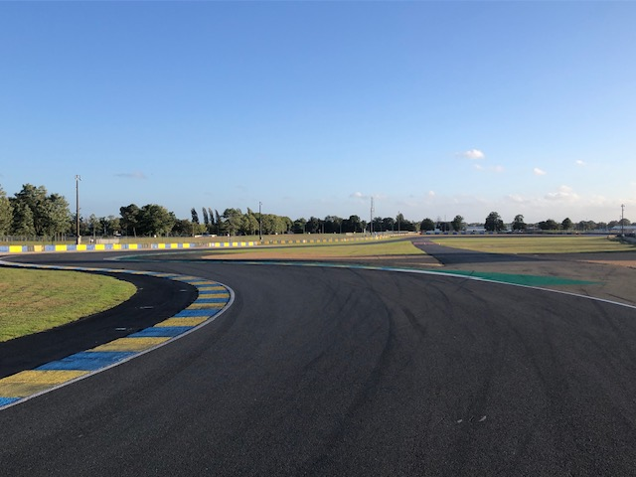
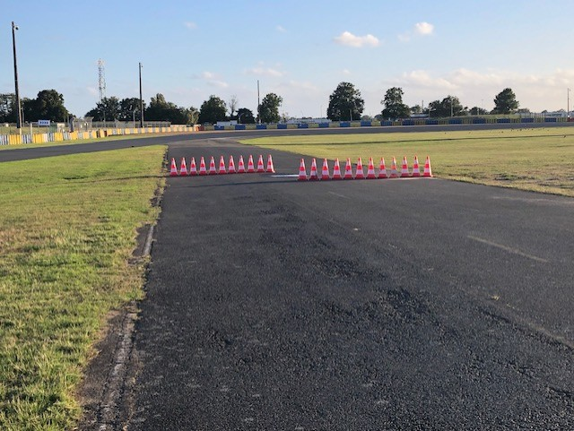
Turn 9 Escape Road
Follow the escape road and negotiate the cone chicane to rejoin safely after Turn 10

Slide 29
Driving standards
Remember this is a NON-CONTACT sport
You need to be aware of all other trucks around you at all times
Make sure the overtake can be completed without contact
Contact is expensive and potentially dangerous
Reported incidents will be reviewed and judicial action may be taken
You may Only Change Direction Once in front of the pursuing truck, that is to say you can only move left or right, not both.
Pushing or Squeezing competitors off the Track is strictly forbidden i.e. reducing the available track width to less than a truck’s width.

Slide 30
Judicial process
All reported Incidents will be reviewed by the Race Director (Noted)
No further Investigation necessary
Under Investigation (referral to the Stewards)
To report an Incident please submit an Incident Review request form to the Race Director within 30 minutes of the provisional results being published.
Only fully completed forms will be accepted and can only be used for incidents in which you were directly involved.
Judicial Investigations & hearings will be handled by the Stewards
Protests may also be lodged directly with the Chairman of the Stewards

Slide 31
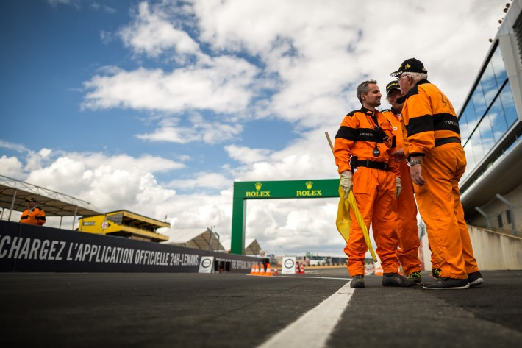
Marshals
Please respect the marshals and remember to give them a wave on the slowing down lap to show your appreciation

Slide 32


